Slide 1
SEARCHING FOR SOLUTIONS
Main reference:
Chapters 3 of Russell, S., & Norvig, P. (2016). Artificial intelligence: a modern approach.

Slide 2






















Two main steps of search algorithms
1. CHOOSE A NODE
2. EXPANDING THE NODE
Repeat these 2 steps until

Slide 3
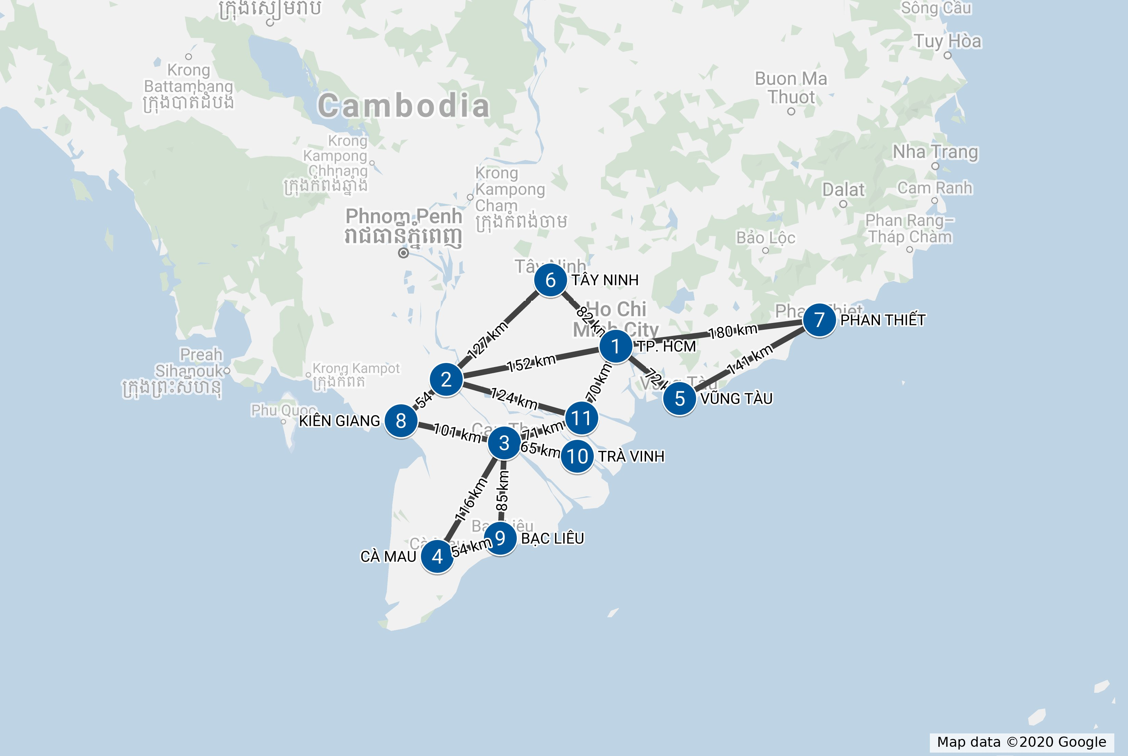
AN GIANG
CẦN THƠ
BẾN TRE

Slide 4
AN GIANG
BẾN TRE

Slide 5
Initial state
BẾN TRE

Slide 6

Expanding BẾN TRE
BẾN TRE
AN GIANG
TP HCM
CẦN THƠ

Slide 7

Expanding AN GIANG
BẾN TRE
AN GIANG
TP HCM
CẦN THƠ
TÂY NINH
BẾN TRE
TP HCM
KIÊN GIANG

Slide 8
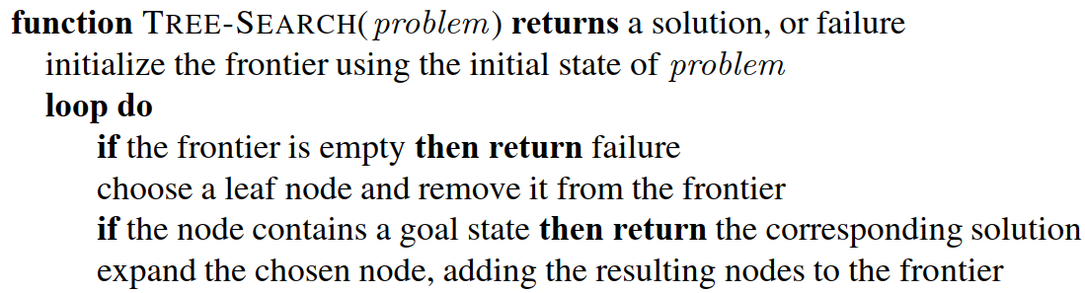





Conceptual algorithm #1 - TREE SEARCH
Source: (Russell, 2016)

Slide 9

Expanding AN GIANG
BẾN TRE
AN GIANG
TP HCM
CẦN THƠ
TÂY NINH
BẾN TRE
TP HCM
KIÊN GIANG

Slide 10


Issue: Repeated states
BẾN TRE
AN GIANG
TP HCM
CẦN THƠ
TÂY NINH
BẾN TRE
TP HCM
KIÊN GIANG

Slide 11
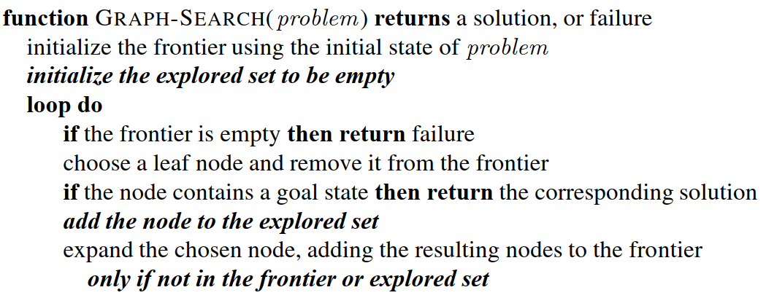





Conceptual algorithm #2 - GRAPH SEARCH
Source: (Russell, 2016)

Slide 12
Developing search algorithms
(from the above conceptual designs)

Slide 13
Two types of search algorithms
Uninformed search:
Informed search:

Slide 14
Uninformed search algorithms

Slide 15































Breadth-ﬁrst search
A simple strategy in which
the root node is expanded ﬁrst,
then all the successors of the root node are expanded next,
then their successors, and so on.

Slide 16
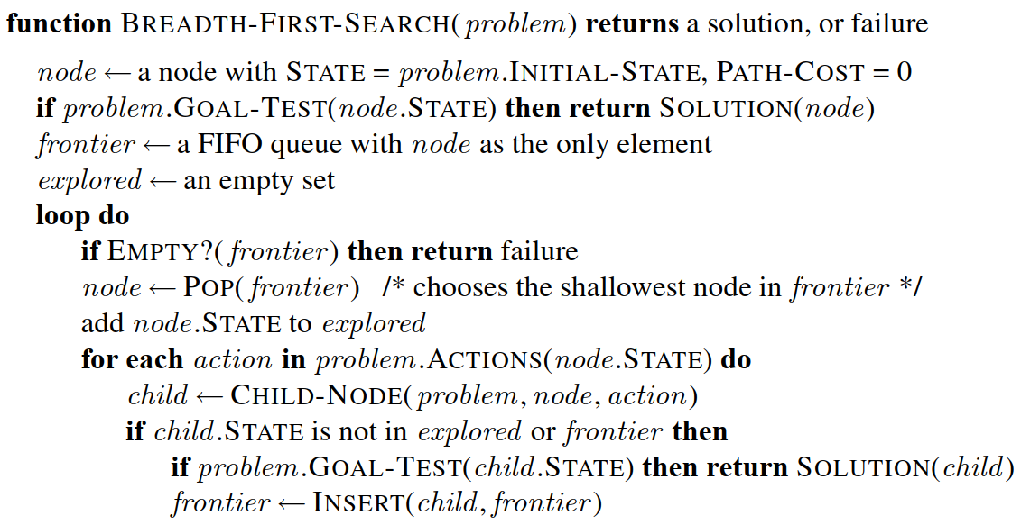
Breadth-ﬁrst search algorithm
Source: (Russell, 2016)

Slide 17












Components of a node
For each node n:
n.STATE:
n.PARENT:
n.ACTION:
n.PATH-COST:

Slide 18



CHILD-NODE(problem, parent, action)

Slide 19


Queues
Operations on a queue:
EMPTY?(queue):
POP(queue):
INSERT(element, queue):

Slide 20






Three common variants of queues
FIFO queue (ﬁrst-in, ﬁrst-out):
LIFO queue (last-in, ﬁrst-out, aka a stack):
Priority queue:

Slide 21



Breadth-ﬁrst search (BFS) algorithm
Source: (Russell, 2016)
Notes:
Why adding ()? See: https://ai.stackexchange.com/questions/17904/understanding-the-pseudocode-of-uniform-cost-search-from-the-book-artificial-in

Slide 22
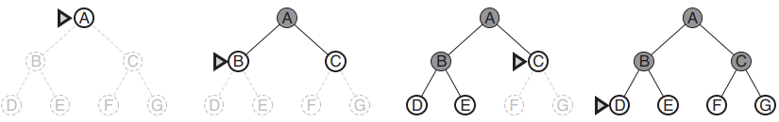

BFS demo
Source: (Russell, 2016)

Slide 23
Animation demo (8-puzzle problem)
http://tristanpenman.com/demos/n-puzzle/

Slide 24




















BFS can find an optimal solution if the path cost is a nondecreasing function of the depth

Slide 25










Example
BẾN TRE
BẾN TRE – TP. HCM – VŨNG TÀU – PHAN THIẾT
BẾN TRE – TP. HCM – PHAN THIẾT

Slide 26





















Example of path cost is NOT a nondecreasing function of the depth

Slide 27







Measuring algorithm's performance
Completeness:
Optimality:
Complexity:
See section 3.3.2 of (Russell, 2016) for more details.

Slide 28
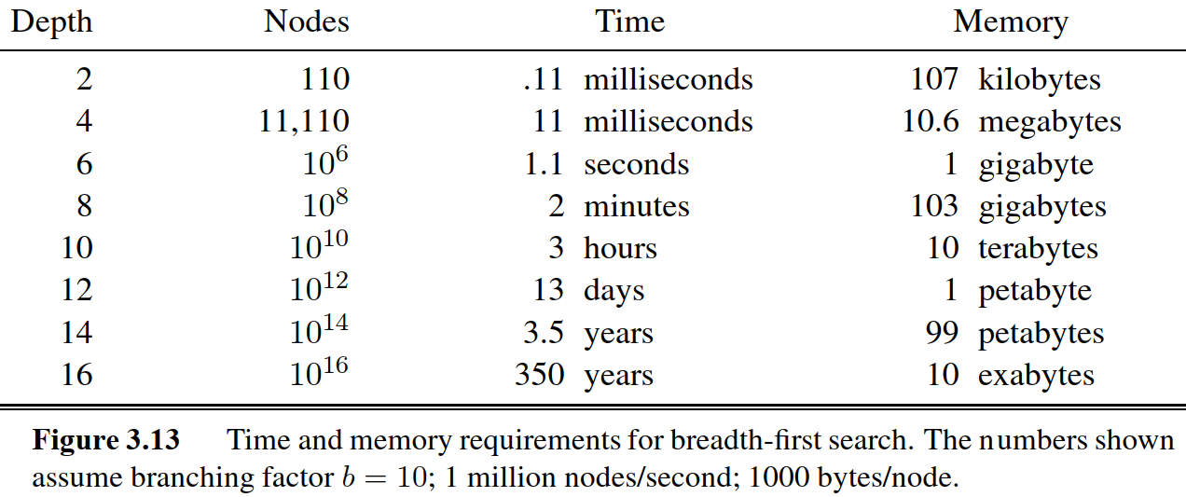




Source: (Russell, 2016)

Slide 29
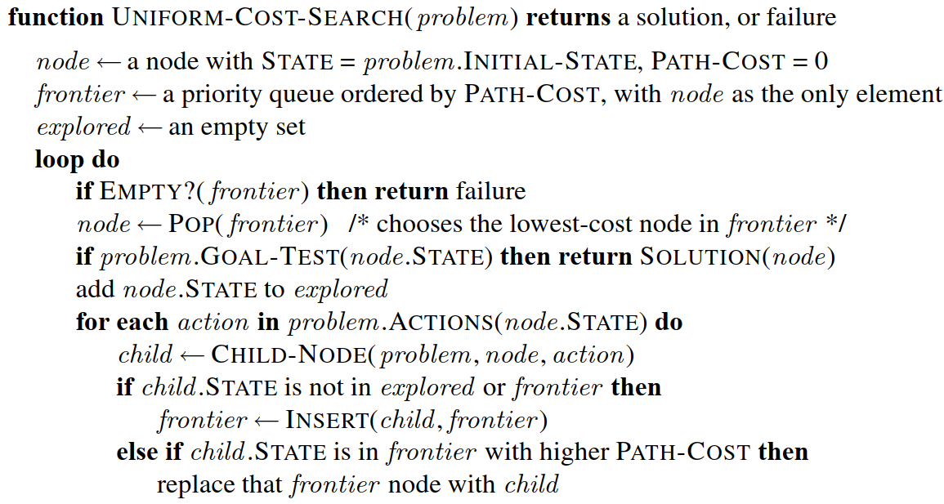






Uniform-cost search algorithm
Source: (Russell, 2016)

Slide 30







Example of path cost is NOT a nondecreasing function of the depth

Slide 32



Depth-ﬁrst search (DFS)
Expands the deepest node in the frontier.

Slide 33
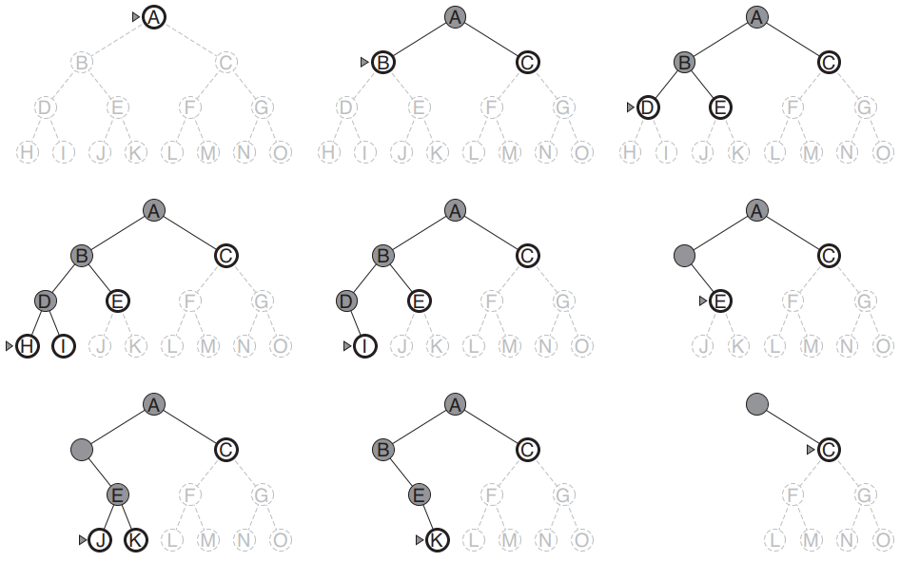














DFS demo
Source: (Russell, 2016)

Slide 34
Animation demo (8-puzzle problem)
http://tristanpenman.com/demos/n-puzzle/

Slide 35


DFS versus BFS
BFS is optimal (with condition). DFS is nonoptimal.
DFS is better than BFS in space complexity,
For example,

Slide 36









































Memory used by BFS and DFS (GRAPH-SEARCH version)

Slide 37




















Memory used by BFS and DFS (GRAPH-SEARCH version)

Slide 38


Memory used by BFS and DFS (TREE-SEARCH version)

Slide 39

















DFS fails when encountering an inﬁnite non-goal path

Slide 40

Depth-limited search
Stop expanding at a predetermined depth limit.
For example,

Slide 41
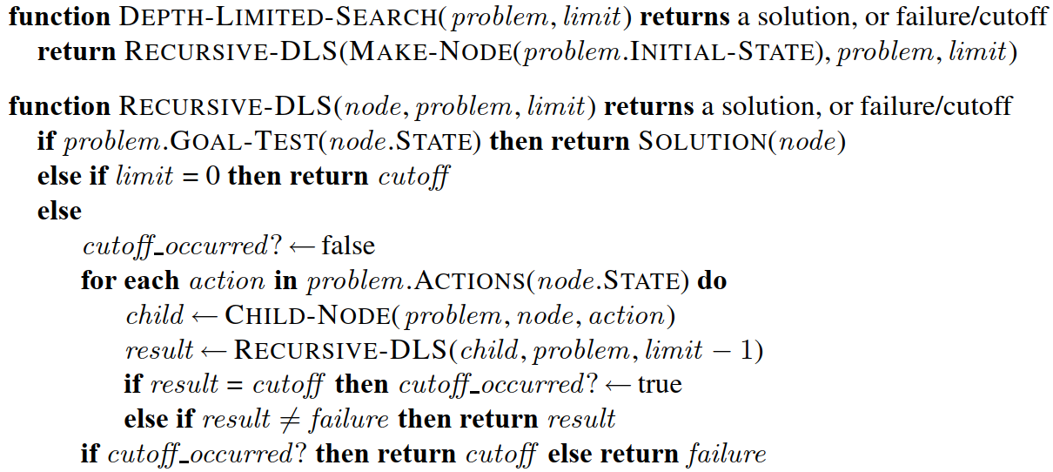












Depth-limited search (TREE-SEARCH version)
Source: Fig. 3.17 of (Russell, 2016)

Slide 42
Issue of depth-limited search
Depth-limited search requires a predetermined depth limit.

Slide 43
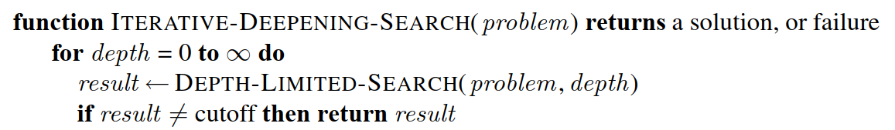







Iterative deepening search

Slide 44





Iterative deepening combines the beneﬁts of depth-ﬁrst and breadth-ﬁrst search:
Like depth-ﬁrst search:
Like breadth-ﬁrst search:
See section 3.4.5 of (Russell, 2016) for more details.

Slide 45
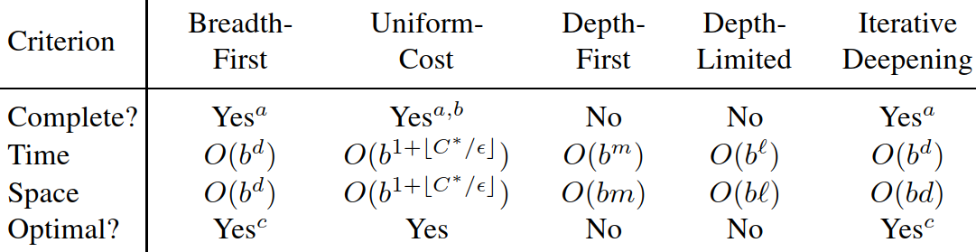
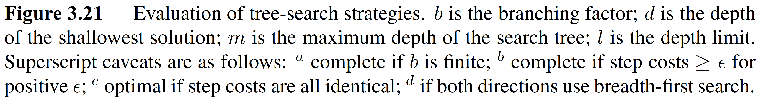




Comparing uninformed search strategies
Source: section 3.4.5 of (Russell, 2016)

